Slide 1
Graph-cut based Image Segmentation

Slide 2
Energy Minimization
Image segmentaion → Labeling

Slide 3
Energy minimization can be solved with graph cuts

Slide 4
Regional term: Penalize pixel label based on local properties

Slide 5
Boundary term:Penalize dissimilar neighbors

Slide 6
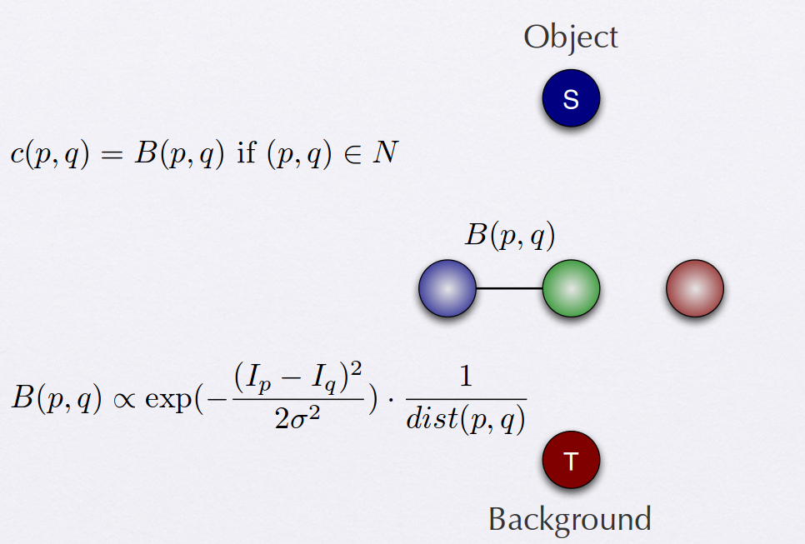
2 links (edges)
1 N-Link

Slide 7
2 links (edges)
2 T-Link

Slide 8
Interactive Segmentation
So-called “interactive”:
  Imposing hard constraints (Indicate the pixels of the object region and the background region by user)
  Question: what do we use these initialized region (or seeds)???
    They are used to define the histograms for the region based segmentation.

Slide 10
Discrete Graph Cut (grid)
Disadvantages:
  Metrication artefacts
  Memory load

